Slide 1


Submitted BY: joyal raju (c0749019) Group #1
INTERFACING STEPPER MOTOR WITH BEAGLEBONE BLACK WIRELESS
PROJECT: IOT BASED SMART CAR PARKING USING BEAGLEBONE BLACK WIRELESS

Slide 2
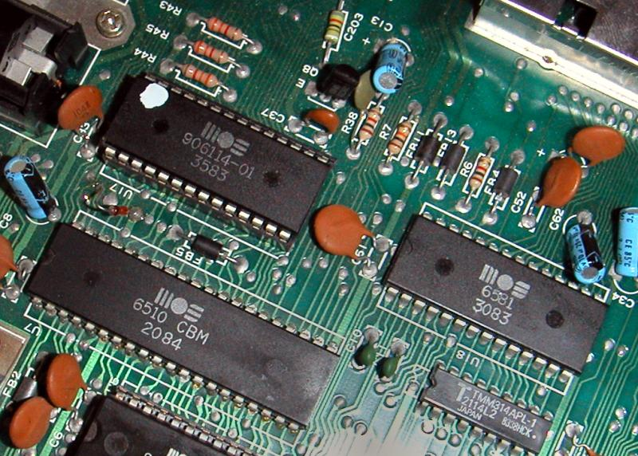
CONTENTs
Introduction
Interfacing Beaglebone Black Wireless with Stepper motor
Connection details
Coding steps
Hardware Circuit
References

Slide 3
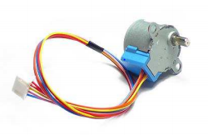
introduction
28BYJ-48 Stepper motor converts electrical pulses into discrete mechanical rotation.
Working voltage is 5V
When electrical signals are applied, stepper motor rotates in accurate and fixed angle increments known as steps.
Number of phases: 4
Used in our project to help the movement of barrier at the entrance

Slide 4
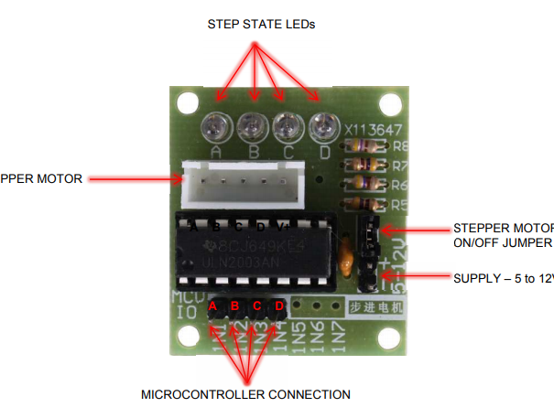
Contd…
ULN2003 is one of the most common driver ICs
It gives a higher current gain
Operating voltage: 5 -12V
The output voltage rating is up to 50V and the output current rating is up to 500mA
The onboard socket is available to directly connect with 28BYJ-48 stepper motor
Used to drive the stepper motor

Slide 5
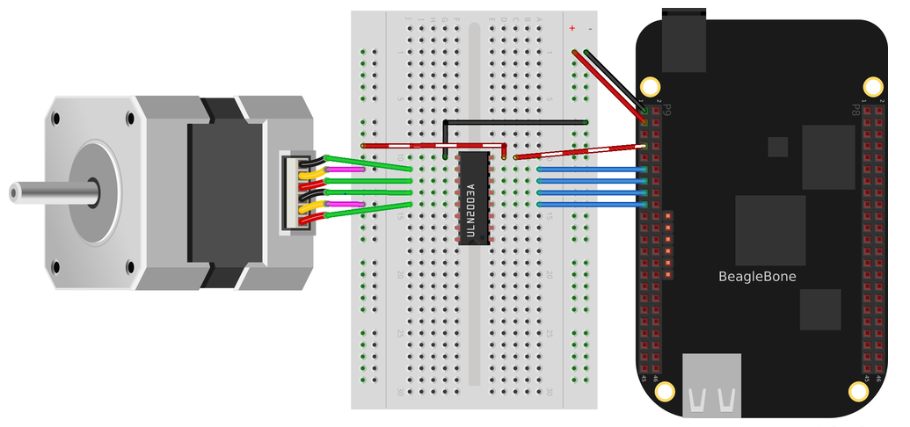
Interfacing Beaglebone Black Wireless with Stepper motor
28BYJ-48 Stepper motor is interfaced with BBB wireless using ULN2003 motor driver
Connection is done by using jumper wires
ULN2003 enables the low voltage and low current of the BBB to drive the higher current stepper motor

Slide 6
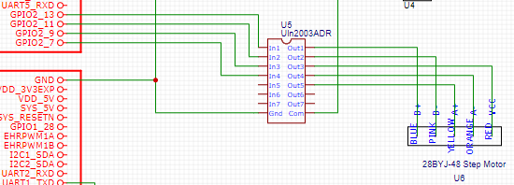
Connection details
The GPIO pins of BBB is fed to the motor driver ULN2003 at the pins ‘In 1’ to ‘In 4’.
The outputs ‘Out1’ to ‘Out5’ from driver is fed to the pins of stepper motor.
Com terminal for driver module is connected to VCC
GND terminal is connected to GND of beaglebone and to common ground bus

Slide 7
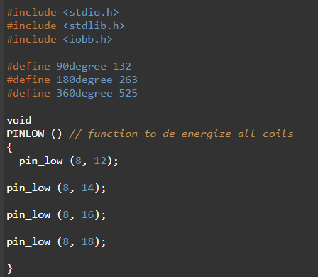
Coding steps
Iobb library is used to easily access the gpio pins of beaglebone black wireless
With iobb library, one can set direction and digital values for the gpio pins
Number of steps corresponding to each angle is defined as macros
PINLOW() function is used to de-energize all coils while switching the steps

Slide 8
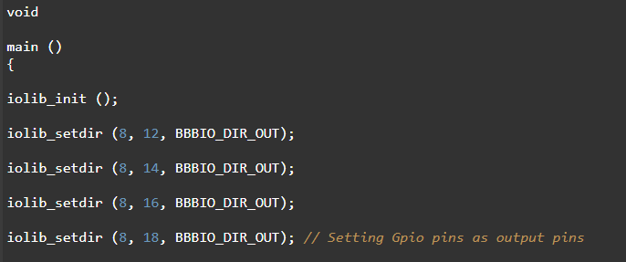
Contd…
In main function iobb library is initialized using “iolib_int()” in order to access the gpio pins
Configure 4 gpio pins as output pins using “iolib_setdir” function.
Gpio 44, gpio 26, gpio 46, gpio 65 pins are used to control in1, in2, in3, in4 of motor driver

Slide 9
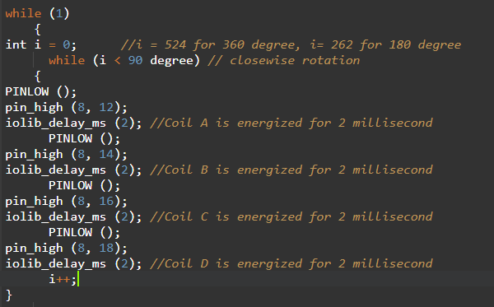
Contd…
Counter “i” is set to compare the steps
PINLOW() function is called each time while energizing each coils to avoid overlapping
Minimum of 2 millisecond is required to energize the coil this is achieved by “iolib_delay_ms” function.
For clockwise rotation, A-B-C-D pattern of energization is used
For anti-clockwise rotation, D-C-B-A pattern of energization is used

Slide 10
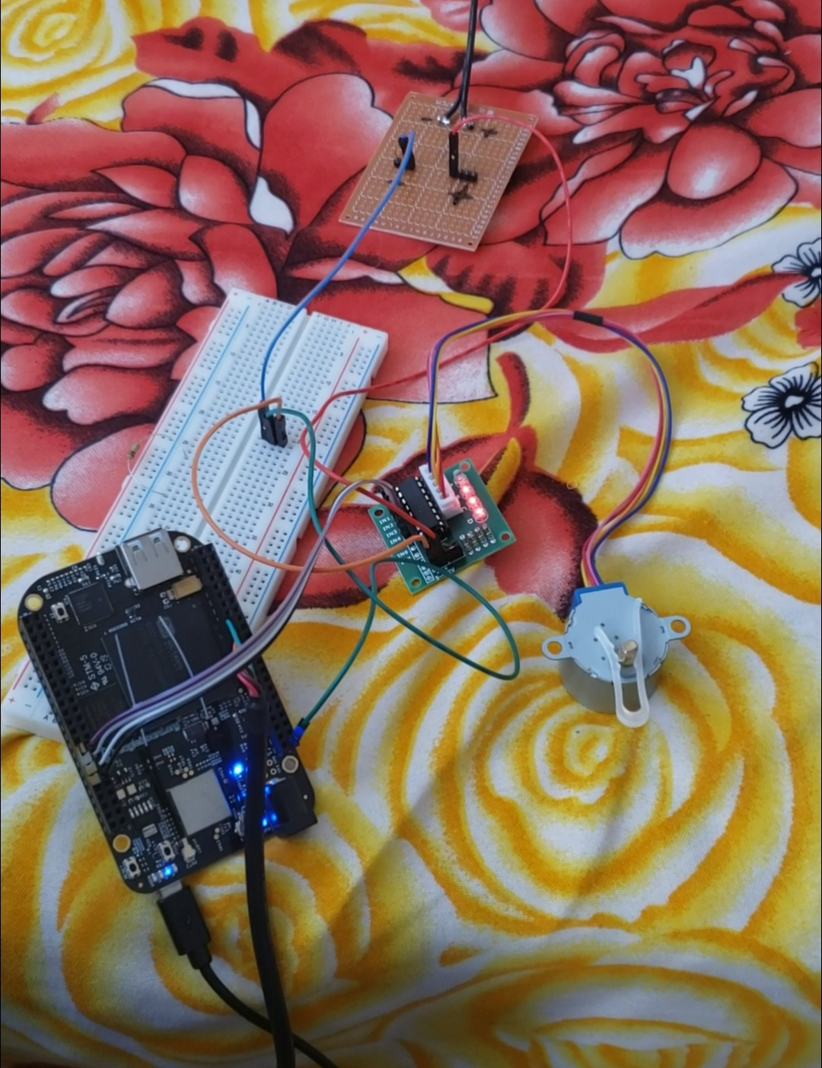
hardware circuit

Slide 11
references
Oreilly(ND). Motors retrieved from: https://www.oreilly.com/library/view/beaglebone-cookbook/9781491915660/ch04.html
Helen (2019). Dummies guide on driving a 28BYJ-48 Stepper Motor with a ULN2003 Driver Board and Arduino retrieved from: https://www.seeedstudio.com/blog/2019/03/04/driving-a-28byj-48-stepper-motor-with-a-uln2003-driver-board-and-arduino/

